Slide 1
Jason Thorpe (he/him)
Community Services Administrator
City of Tucson Housing and Community Development Department
EFFECTIVE USE OF ESG, HOME- ARP FOR HOMELESS STRATEGIES
National Community Development Association – Orlando, Florida

Slide 2
CITY OF TUCSON HOUSING AND COMMUNITY DEVELOPMENT DEPARTMENT
Public Housing Authority (City, County)
Entitlement Jurisdiction (CDBG, ESG, HOPWA, HOME)
HOME Consortium Lead
Continuum of Care Lead Agency/Collaborative Applicant
Nonprofit Development Corporation – El Pueblo Housing Development
www.tucsonaz.gov/hcd

Slide 3
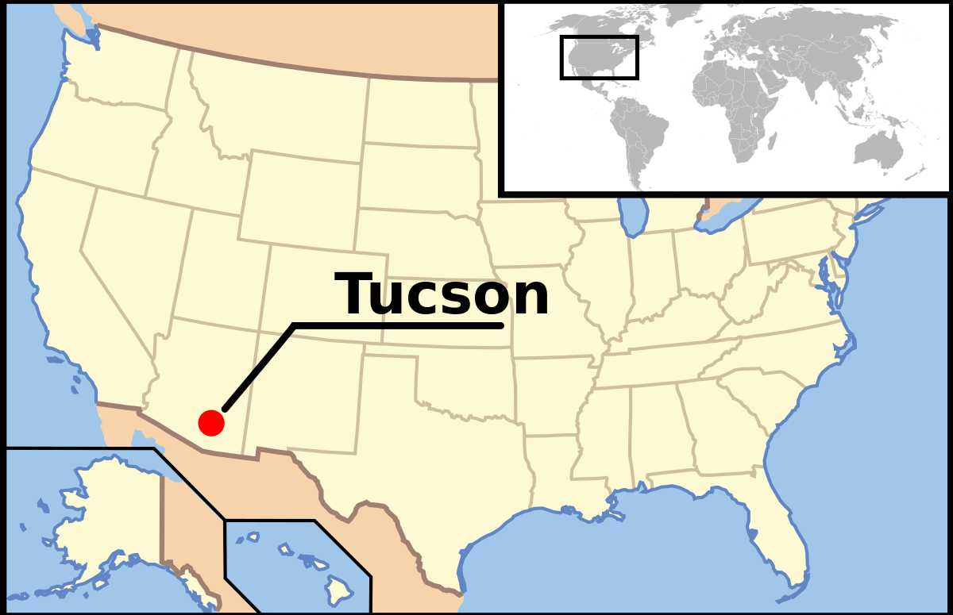
TUCSON, ARIZONA
Population: 546,574 (city), 1,072,298 (metro area)
Land Mass: 227 sq. miles, located 60 miles north of U.S./Mexico border
Median household income: $48,058
Poverty Rate: 19.8%
1 affordable and available rental unit for every 4.2 extremely low-income households
Low comparative costs of living result in affordability mirage

Slide 4
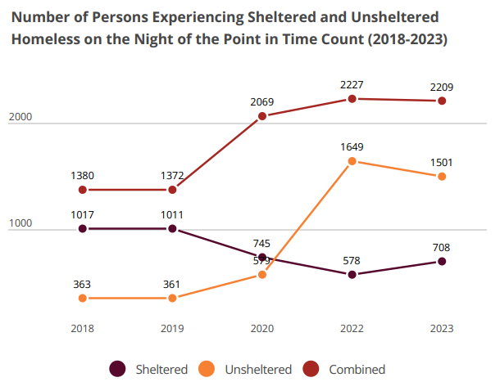
HOMELESSNESS
IN TUCSON

Slide 5
HOMELESS SOLUTIONS - ENGAGEMENT
Street Outreach & Encampment Response
City General Fund
ESG
ARPA State Fiscal Recovery Fund
CDBG-CV
Housing Navigation & Care Coordination
ARPA State Fiscal Recovery Fund
CoC Coordinated Entry Funds
CDBG (Annual, CV)
Mobile Shower Program
City General Fund
ARPA State Fiscal Recovery Fund
CoC Unsheltered NOFO Funds (beginning soon)
City General Fund

Slide 6
HOMELESS SOLUTIONS – SHELTER & HOUSING
Non-Congregate Shelter Programs
City General Fund
ESG (Annual, CV)
ARPA Local Fiscal Recovery Fund
HOME-ARP*
Rental Assistance
ESG
PHA Preference
HOME (HCV security deposit assistance)
CoC supportive services + PHA vouchers (ECHO)
City General Fund
State Housing Trust Fund
CDBG (Annual, CV)
HOPWA
CDBG (<90 days, emergency assistance, arrears)
ESG (public housing homelessness prevention)
CDBG-CV supportive services + PHA vouchers (Tucson HEART)
CoC move-on strategy

Slide 7
ACCELERATING OUR WORK WITH HOME-ARP
$12.7M Allocation
Allocation Plan Approved March 2022
Capital Project Focus

Slide 8
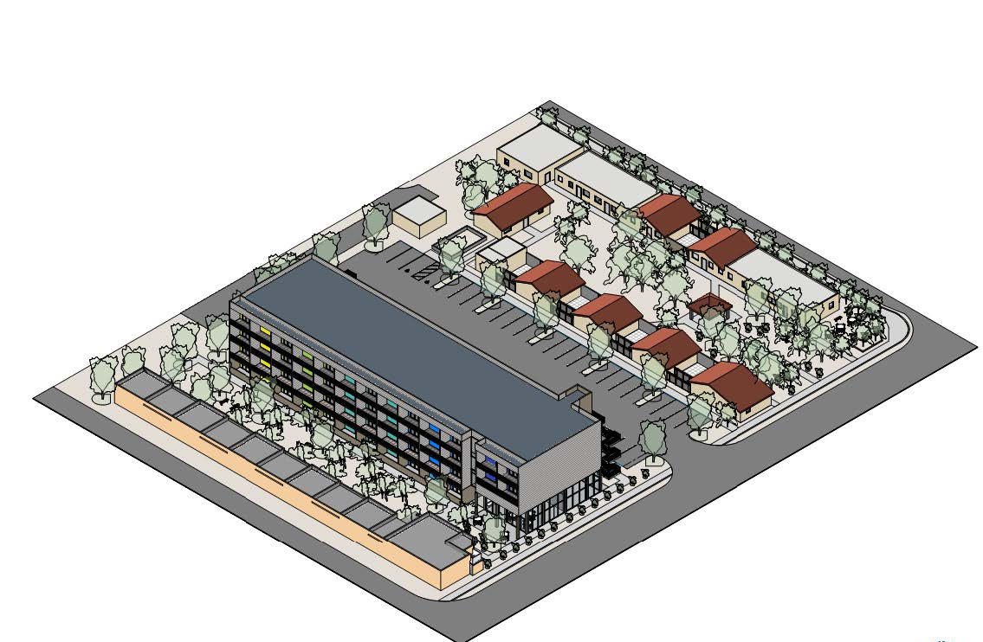
RENTAL HOUSING ACTIVITIES
Sleepy Hollow
$21M
44 Family Units (14 qualifying pop.)
$2M HOME-ARP, 4% LIHTC
Milagro on Oracle
$19M
63 Older Adult Units (2 qualifying pop.)
3200 W Valencia
$51.5M
264 Family Units (2 qualifying pop.)
$500K HOME-ARP, 4% LIHTC
44 Project Based Vouchers
$500K HOME-ARP, $350K ARPA Fiscal Recovery Funds, 9% LIHTC
19 CoC Permanent Supportive Housing Units (HCV + Supportive Services)

Slide 9
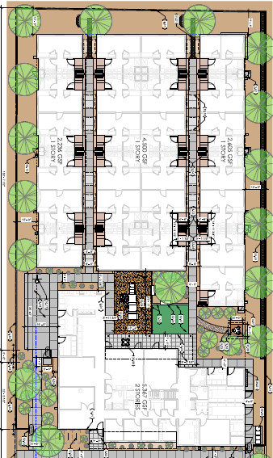
NON-CONGREGATE SHELTER ACTIVITIES:
DOMESTIC VIOLENCE SHELTER
Emerge Center Against Domestic Abuse
Demolition of existing congregate facility and construction of larger non-congregate shelter.
25 non-congregate units for individuals and families
$1M HOME-ARP, $1M ARPA County Fiscal Recovery Funds, $250K CDBG Public Facilities, $1.7M private philanthropy
Annual Operating Funds include ESG, VOCA, State Grants, City/County General Funds, and Private Philanthropy

Slide 10
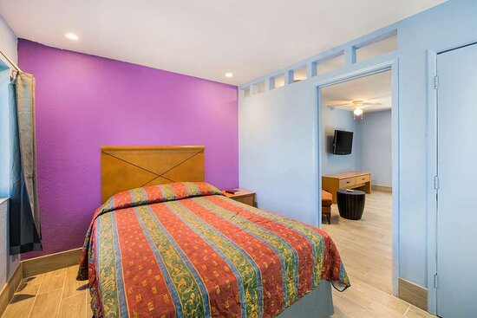
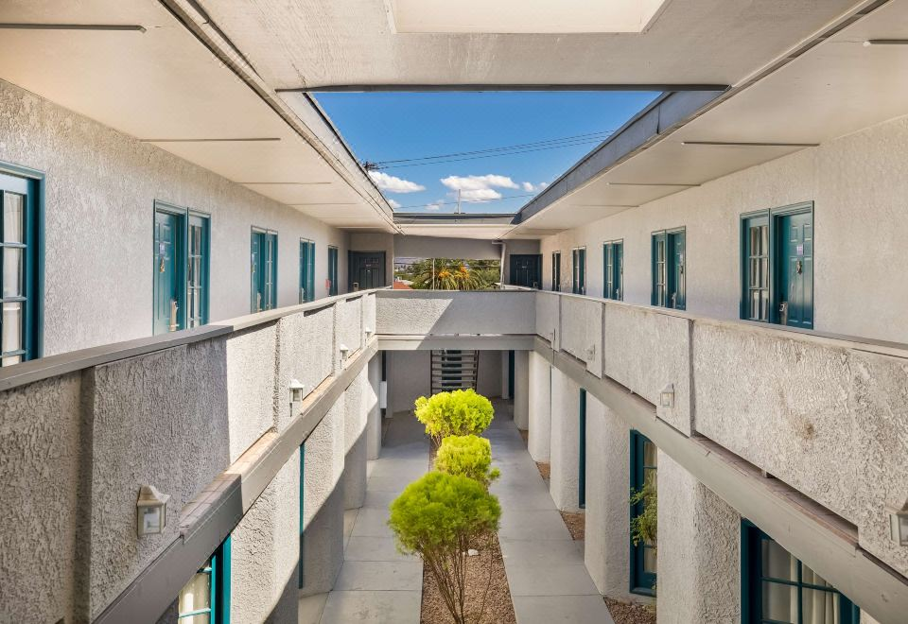
NON-CONGREGATE SHELTER ACTIVITIES:
MOTEL CONVERSION
Proposed City/County Partnership
Acquisition and Rehabilitation of 67-Unit Motel
$4.3M Acquisition (HOME-ARP/CDBG)
$3.2M Rehabilitation (HOME-ARP/CDBG)
Planned Conversion to Permanent Supportive Housing After 5 Year Use Period
Annual Operating Funds Include: ESG, City/County General Funds, CDBG-CV, HOME-ARP Supportive Services

Slide 11
LESSONS LEARNED & TIPS
Match HOME-ARP activities to your community’s need. There’s no perfect recipe.
HOME-ARP TBRA and Supportive Services funds can be used to extend the CARES Act funding cliff if strategically aligned.
Don’t be afraid to amend your plan. Community conditions are evolving.
Prepare your staff and partners (developers, subrecipients, etc.) HOME-ARP is not HOME. HOME-ARP is not ESG.

Slide 12
MORE LESSONS LEARNED & TIPS
Explore PHA partnerships and LIHTC opportunities to stretch development dollars further.
Beware what you braid – incompatible federal requirements can create a challenge. Negotiate LIHTC compatibility with State early.
Watch for compliance supplement releases (used by auditors) and HUD monitoring guides for HOME-ARP. Over-document your decisions, actions, and justifications.
Pair ESG with HOME-ARP shelter activities to preserve intake prioritization practices.
Build a community of practice around you!

Slide 13
Thank You!
Jason Thorpe
Community Services Administrator
(520) 437-5137
jason.thorpe@tucsonaz.gov

